Slide 1
Privacy Enabled Noise-Free Data Collection In Vehicular Networks
MS Thesis Defense
Anuj Dimri
Notes:
In this thesis, we studied how we can collect location based data from vehicular users.
Vehicles can communicate with each other.
Transportation data has wealth of information, how can we do so in privacy preserved manner

Slide 2
Ease of Collecting Location Based Data

Slide 3

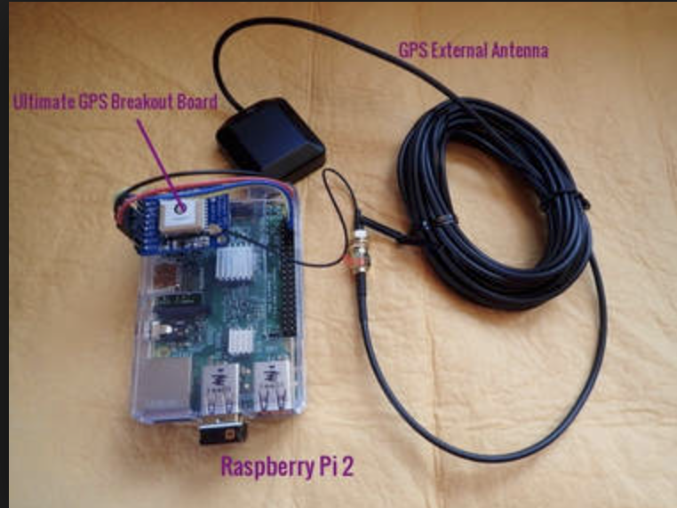

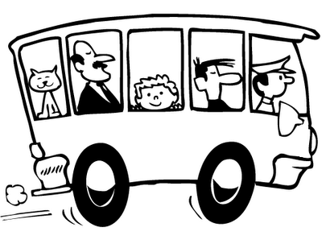

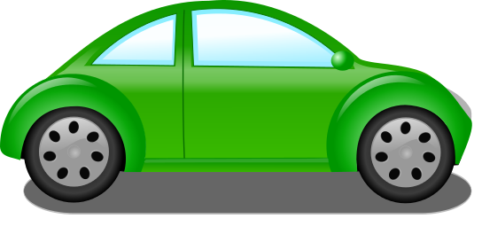

Computing
cloud
Data Collector
(Server)

Slide 4
Need for Collecting Location Based Data

Slide 5
Different Applications tied to Location Based Data
Dynamic Congestion Map of a city
Emissions and air pollution modeling
Homeland Security Evacuation
Validating transportation data from other sources

Slide 6
Location Privacy is a concern
Adversary can come to know personal information about users.
If location is known-
Driving patterns
Frequently visited places (Religious beliefs, Political affiliations)
Track a user

Slide 7
How To Preserve Location Privacy?

Slide 8
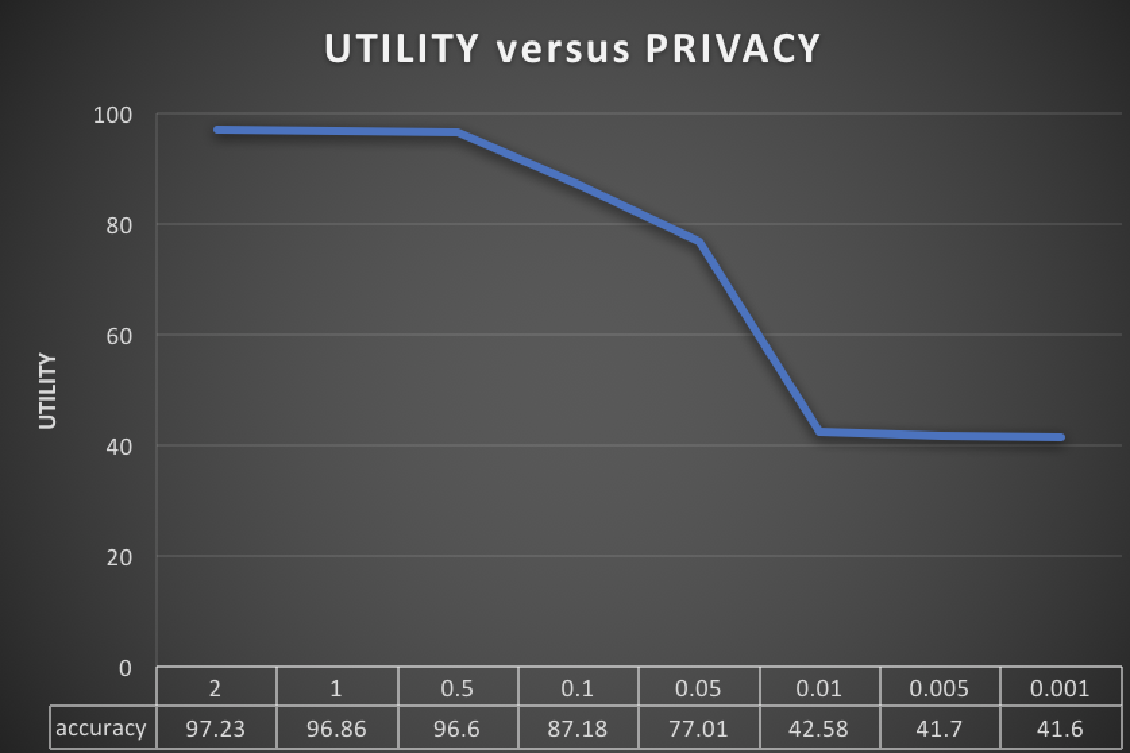
Group Pseudonym
Use of pseudonym IDs
Adding noise to data samples
Location Privacy Preserving Techniques
Noise-free data samples
Compromise on accuracy because of privacy
No decrease in utility
Utility privacy trade-off
OUR WORK!!

Slide 9
Focus of our work
Privacy Enabled Noise-Free data collection in Vehicular Networks

Slide 10
Outline
Adversary Model
Methodology
Adversary Attack
Defender Approach
Evaluation
Conclusion

Slide 11
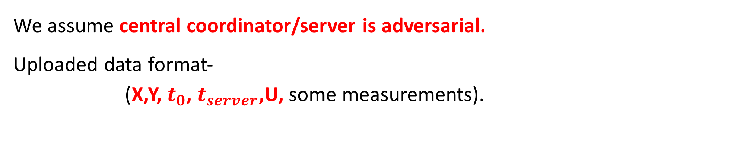
Adversary Model
We assume central coordinator/server is adversarial.
Uploaded data format-
(X,Y, $t_{0}$, $t_{server}$,U, some measurements).
Latitude, longitude where data was collected
Unique ID of vehicle which uploads data
Application specific data RSS values, speed of the vehicle, etc.
Time at which data was collected
Time at which data was uploaded to server
Server has knowledge of topology of entire city like street network, speed limits on all streets, number of lanes, etc.

Slide 12
Methodology

Slide 13
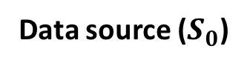
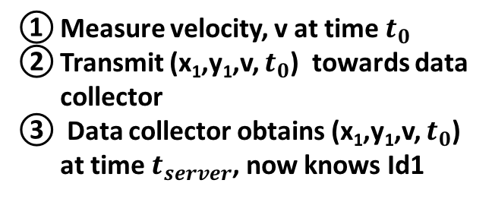
Basic Approach
Computing
cloud
Measure velocity, v at time $t_{0}$
Transmit (x₁,y₁,v, $t_{0}$) towards data collector
Data collector obtains (x₁,y₁,v, $t_{0}$) at time $t_{server}$, now knows Id1
Data uploaded directly.
Location privacy not preserved.
Data Collector
(Server)
3
Communication Network
(x₁, y₁)
2
Id1
Data source ($S_{0}$)
1

Slide 14
Introducing Indirections
Data not uploaded to server directly.
Each node has an option of forwarding data to one of its neighboring node with some probability or upload data to server.
Data could take multiple hops to reach server.

Slide 15
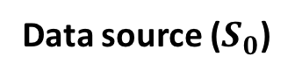
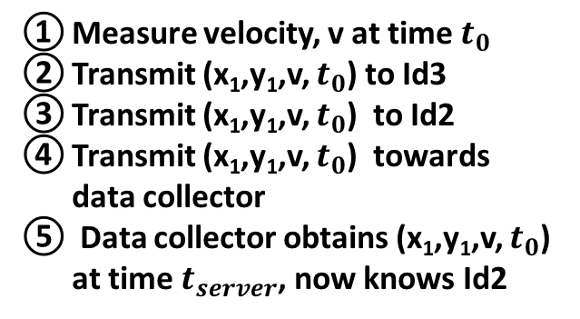
Indirections Example
Computing
cloud
Measure velocity, v at time $t_{0}$
Transmit (x₁,y₁,v, $t_{0}$) to Id3
Transmit (x₁,y₁,v, $t_{0}$) to Id2
Transmit (x₁,y₁,v, $t_{0}$) towards data collector
Data collector obtains (x₁,y₁,v, $t_{0}$) at time $t_{server}$, now knows Id2
Data Collector
(Server)
Data uploaded after multiple hops
5
Communication Network
4
Id2
Id3
(x₃, y₃)
(x₅, y₅)
3
Id5
(x₂, y₂)
(x₁, y₁)
Id4
2
Id1
Data source ($S_{0}$)
(x₄, y₄)
1

Slide 16
Effect on Location Privacy
Notes:
Before this, I need to tell you how vehicular communication happens.

Slide 17
To make vehicles communicate with each other, we use Dedicated Short Range Communication (DSRC) protocol.
DSRC features-
Operates in 5.9GHz
Maximum range is 1000 meters
Range depends on application & typically lies in 100-300 meters
Each transmission takes 100 milliseconds

Slide 18
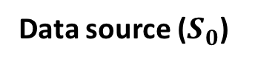
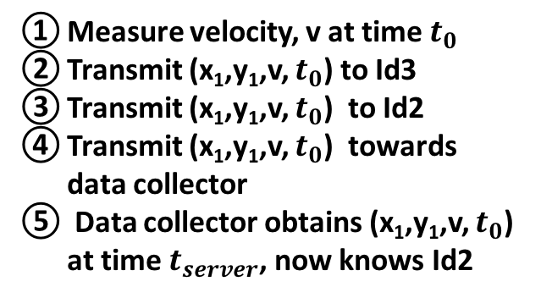
Effect on Location Privacy
Computing
cloud
Measure velocity, v at time $t_{0}$
Transmit (x₁,y₁,v, $t_{0}$) to Id3
Transmit (x₁,y₁,v, $t_{0}$) to Id2
Transmit (x₁,y₁,v, $t_{0}$) towards data collector
Data collector obtains (x₁,y₁,v, $t_{0}$) at time $t_{server}$, now knows Id2
Data Collector
(Server)
Total delay after which data uploaded is 300 ms (Each DSRC transmission is 100 ms).
In 300 ms, distance traveled by Id1 is very less (5.36 meters if traveling at 40 mph).
Users localized within a small area.
5
Communication Network
4
Id2
Id3
(x₃, y₃)
(x₅, y₅)
3
Id5
(x₂, y₂)
(x₁, y₁)
Id4
2
Id1
Data source ($S_{0}$)
(x₄, y₄)
1

Slide 19
Can we do better ?

Slide 20
Also Introduce Random Delays
Introduce random delay before sending data to next node.
This gives data source time window to travel away from data collection location.
Data uploader is also weakly associated with the location where data was collected.

Slide 21
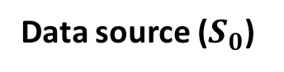
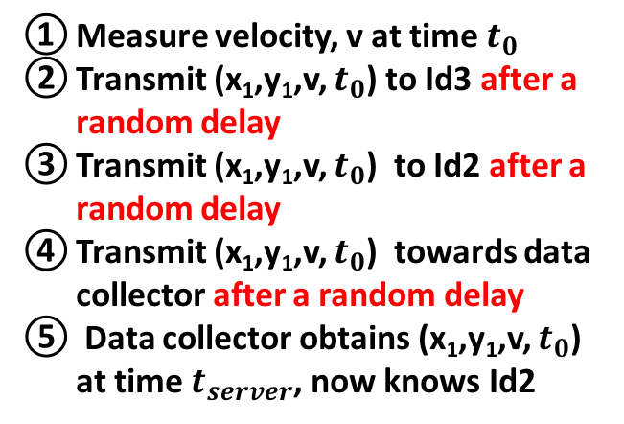
Random Delays + Indirections
Computing
cloud
Measure velocity, v at time $t_{0}$
Transmit (x₁,y₁,v, $t_{0}$) to Id3 after a random delay
Transmit (x₁,y₁,v, $t_{0}$) to Id2 after a random delay
Transmit (x₁,y₁,v, $t_{0}$) towards data collector after a random delay
Data collector obtains (x₁,y₁,v, $t_{0}$) at time $t_{server}$, now knows Id2
Data Collector
(Server)
5
Data uploaded after multiple hops
Communication Network
4
Id2
Id3
(x₃, y₃)
(x₅, y₅)
3
Id5
(x₂, y₂)
(x₁, y₁)
Id4
2
Id1
Data source ($S_{0}$)
(x₄, y₄)
1

Slide 22
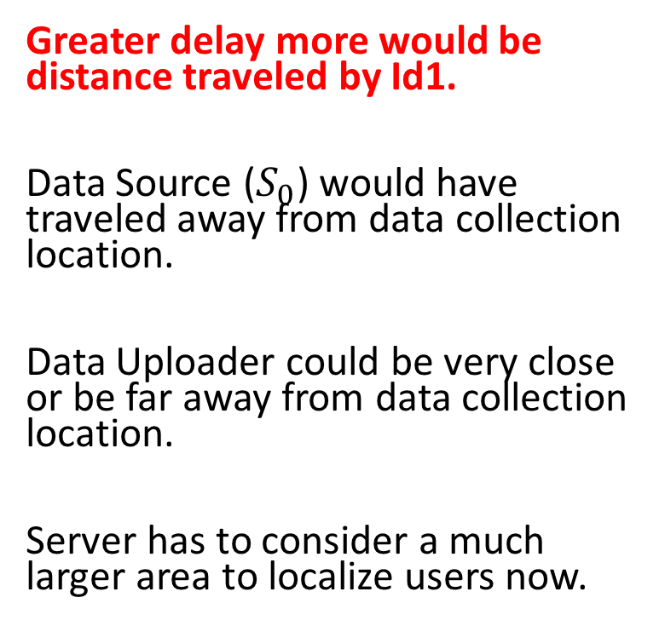
Effect on Location Privacy
Computing
cloud
Measure velocity, v at time $t_{0}$
Transmit (x₁,y₁,v, $t_{0}$) to Id3 after a random delay
Transmit (x₁,y₁,v, $t_{0}$) to Id2 after a random delay
Transmit (x₁,y₁,v, $t_{0}$) towards data collector after a random delay
Data collector obtains (x₁,y₁,v, $t_{0}$) at time $t_{server}$, now knows Id2
Greater delay more would be distance traveled by Id1.
Data Source ($S_{0}$) would have traveled away from data collection location.
Data Uploader could be very close or be far away from data collection location.
Server has to consider a much larger area to localize users now.
Data Collector
(Server)
5
Communication Network
4
Id2
Id3
(x₃, y₃)
(x₅, y₅)
3
Id5
(x₂, y₂)
(x₁, y₁)
Id4
2
Id1
Data source ($S_{0}$)
(x₄, y₄)
1

Slide 23
Adversary Approach

Slide 24
Can adversary still accurately localize Data Uploader?

Slide 25
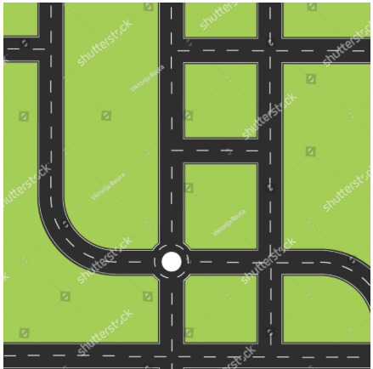
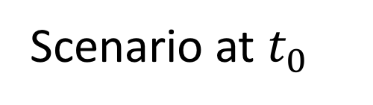
Scenario at $t_{0}$
Data Source
Data Uploader (U)
Intermediate Nodes
Notes:
https://clipartxtras.com/download/c800bdd9db537a630f6ac1cd0e79edf3e753e0a8.html

Slide 26
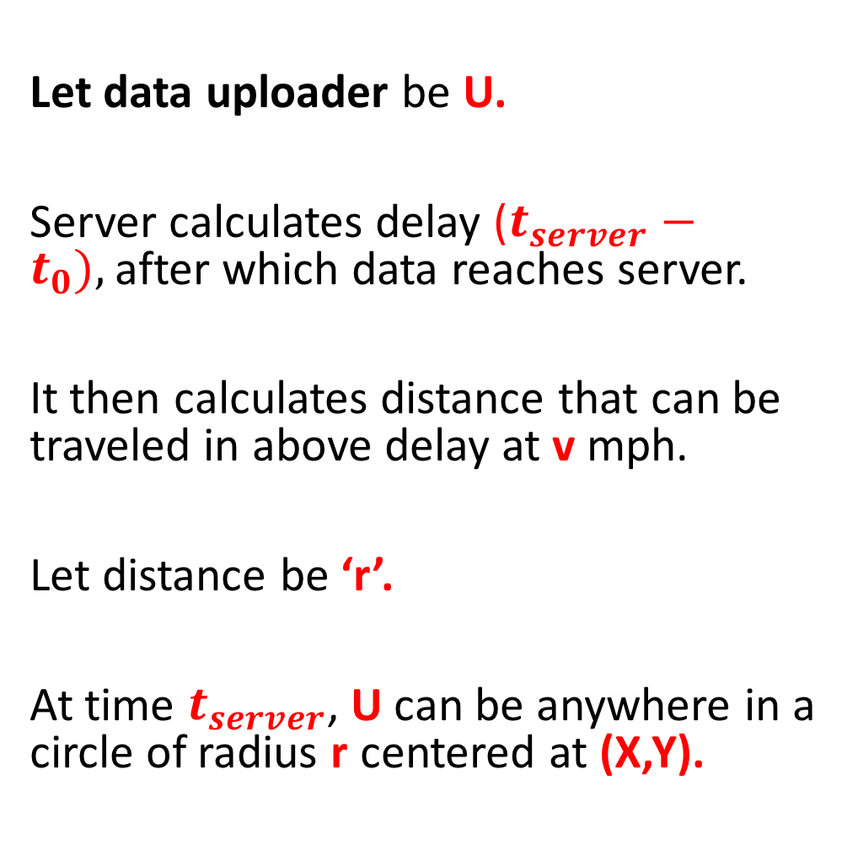
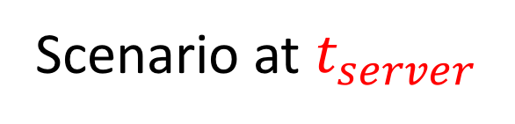
Let data uploader be U.
Server calculates delay ($t_{server}−t_{0}),$after which data reaches server.
It then calculates distance that can be traveled in above delay at v mph.
Let distance be ‘r’.
At time $t_{server}$, U can be anywhere in a circle of radius r centered at (X,Y).
Scenario at $t_{server}$
r
Data Source
Data Uploader (U)
Intermediate Nodes

Slide 27
Scenario after first upload
When U uploads data first time server draws circle of radius r.
Center of this circle be z1, let us name this circle C1.
z1 is point where data is collected by source. (Same as X,Y in previous slide)
r
z1
C1

Slide 28
After multiple uploads by same U
r
z3
r
r
z1
z2
r
z4
r
C3
r
z6
z5
C1
C2
C4
C6
C5
Scenario after 6 uploads made by U

Slide 29
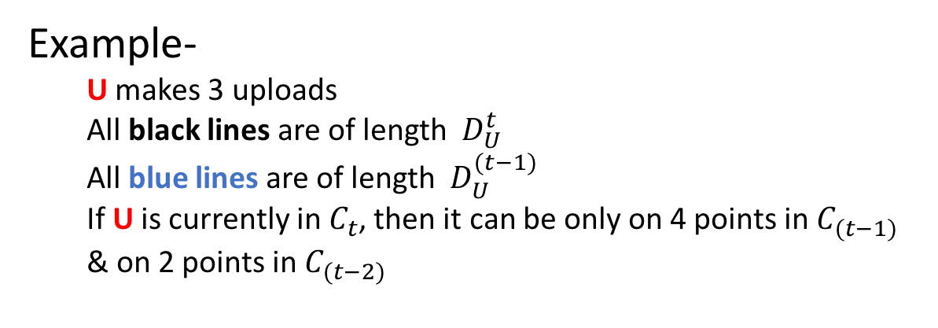
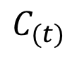
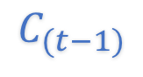
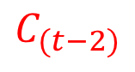
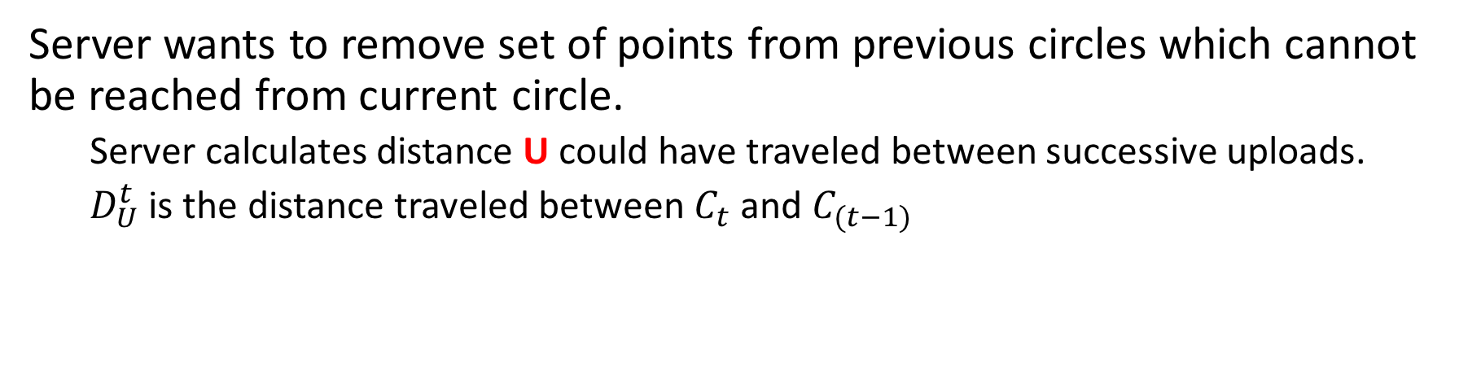
Server’s Intuition
Server wants to remove set of points from previous circles which cannot be reached from current circle.
Server calculates distance U could have traveled between successive uploads.
$D_{U}^{t}$ is the distance traveled between $C_{t}$ and $C_{(t−1)}$
Example-
U makes 3 uploads
All black lines are of length ${ D}_{U}^{t}$
All blue lines are of length ${ D}_{U}^{(t−1)}$
If U is currently in $C_{t}$, then it can be only on 4 points in $C_{(t−1)}$ & on 2 points in $C_{(t−2)}$
$$C_{(t−1)}$$
$$C_{(t−2)}$$
$$C_{(t)}$$

Slide 30
Uploader Localization
If same U uploads more and more data (more circles will be formed), number of possible points to reach previous circle keeps on decreasing.
Uploader is localized if adversary comes to know at which point uploader was in past.
Adversary can then correlate data collected from that point with U.

Slide 31
Scenario at $t_{server}$
r
Data Source
Data Uploader (U)
Intermediate Nodes

Slide 32
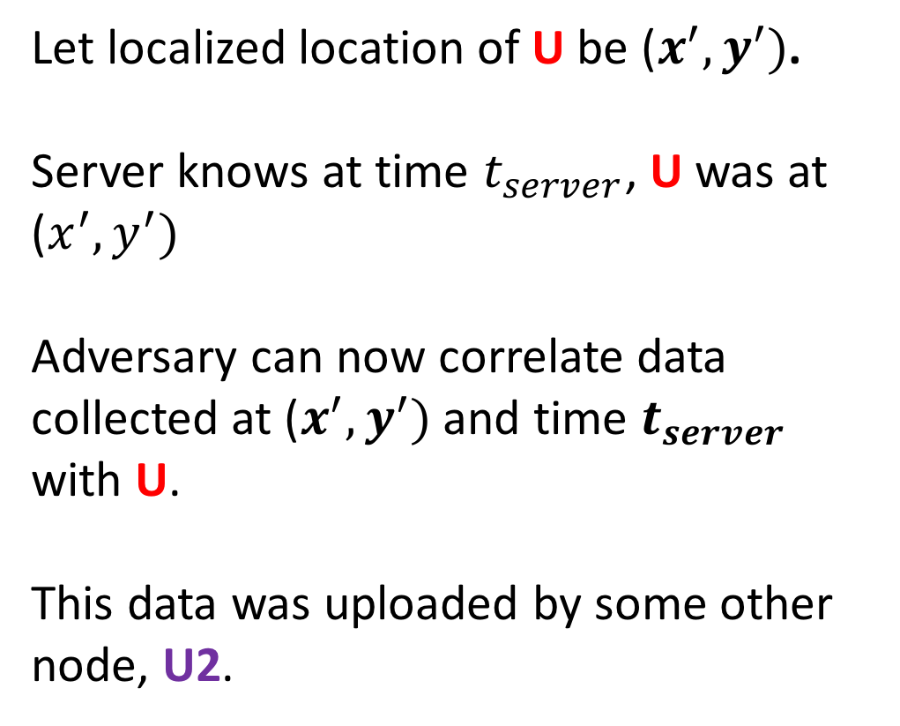
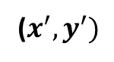
Let localized location of U be ($x^{′},y^{′})$.
Server knows at time $t_{server}$, U was at ($x^{′},y^{′})$
Adversary can now correlate data collected at ($x^{′},y^{′})$ and time $t_{server}$ with U.
This data was uploaded by some other node, U2.
($x^{′},y^{′})$
Data Uploader 2 (U2)
Data Source
Data Uploader (U)
Intermediate Nodes

Slide 33
Real World City
Maps are stored in the form of graphs
Road segments are represented as edges with nodes as end points
Changes in adversary approach-
Circles replaced by graph
Possible points replaced by nodes and edges remaining after pruning the graph.
Adversary performs Graph Pruning.

Slide 34
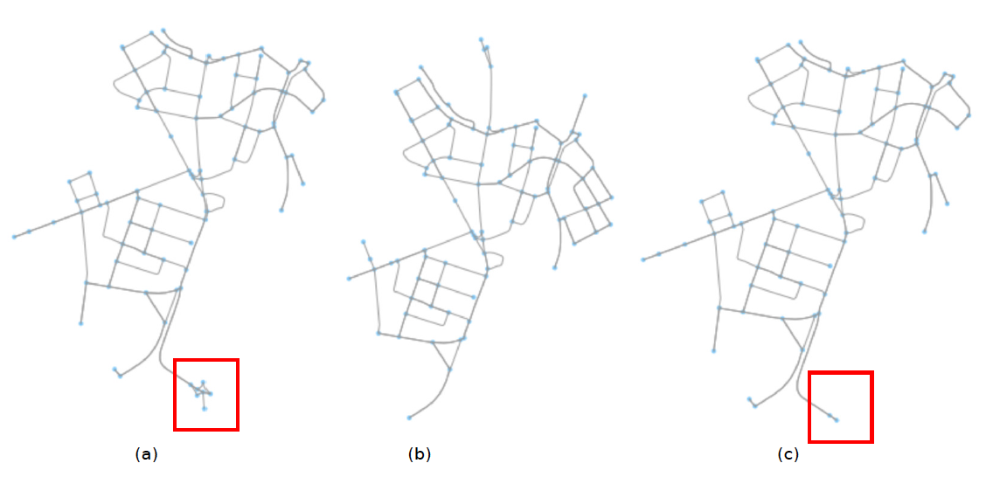
Graph Pruning
G1
G2
Pruned G1

Slide 35
Defender Approach

Slide 36
Uploader Strategy
Not upload a data packet which has been collected recently.
Uploader very close to data collected location
Not make frequent uploads within a short span of time.
Adversary able to prune large number of nodes from previous graphs.

Slide 37
Uploader Algorithm
Uploader runs an algorithm to decide whether it is safe for it to upload data to server or not.
If an upload leads to uploader being localized, uploader would not upload data to server.
Instead data would be forwarded to one of neighboring node.

Slide 38
Application

Slide 39
Evaluation

Slide 40
Goal of Evaluation
How well can an adversary localize an uploader and how an uploader can prevent itself from being localized

Slide 41
Simulations
We simulate vehicular communication network.
Vehicles need to move on road segments, follow traffic rules and communicate with each other.
No single simulator served our purpose, so we used suite of simulators.

Slide 42
Suite of Simulators Used
SUMO- Simulation of Urban Mobility
Used for Vehicle simulations
OMNeT++
Used for network simulations
Veins
Framework which interacts with SUMO and OMNeT++.
As vehicles move in SUMO, updates of their positions are made in OMNet++ simulator as movement of nodes with help of Veins.

Slide 43
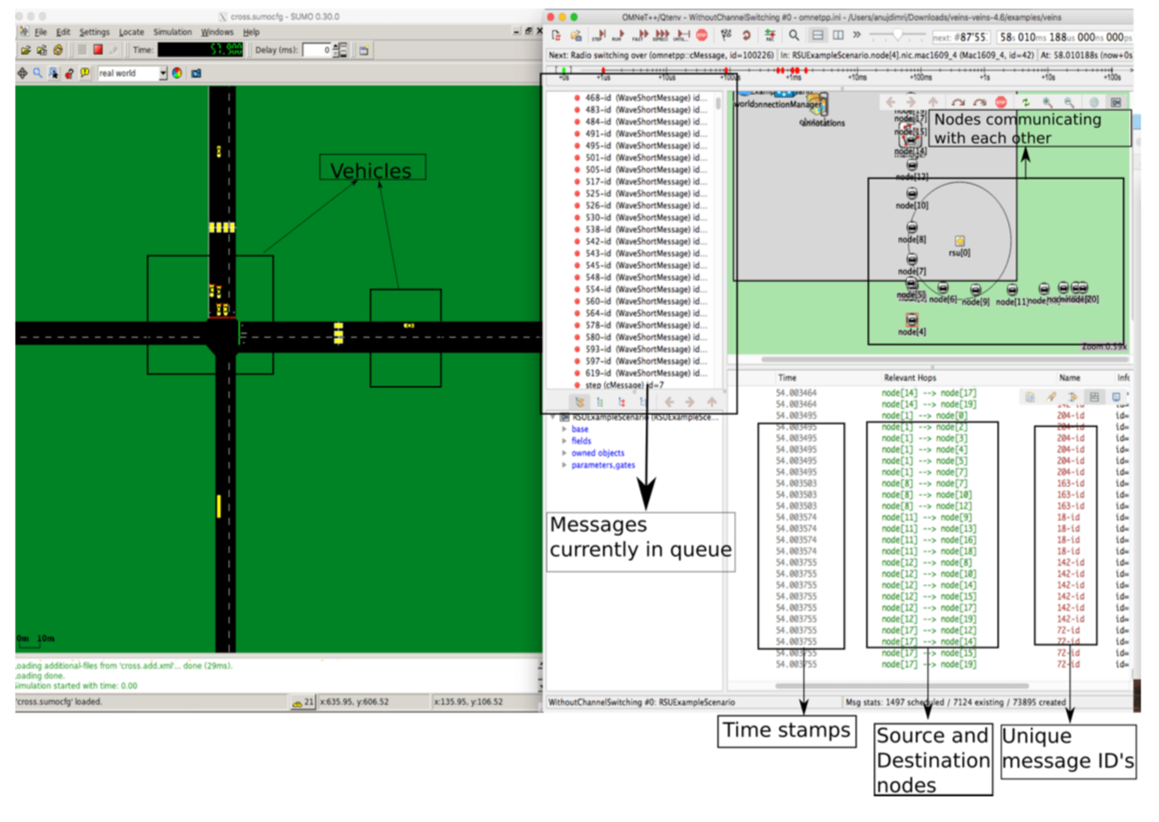
Simulation Setup

Slide 44
Privacy Metrics
K-anonymity (one of K values) - Larger value of K, greater is privacy guarantee. In our problem, ‘K’ is number of different streets, so user can be in any one of ‘K’ streets.
Length of region of interest (L) - Total region where adversary thinks uploader could be.

Slide 45
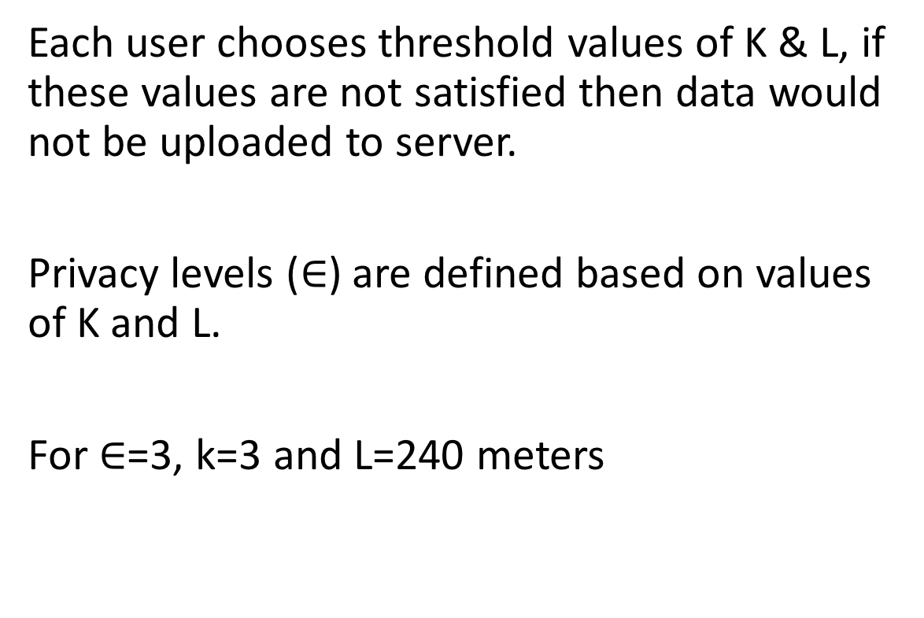
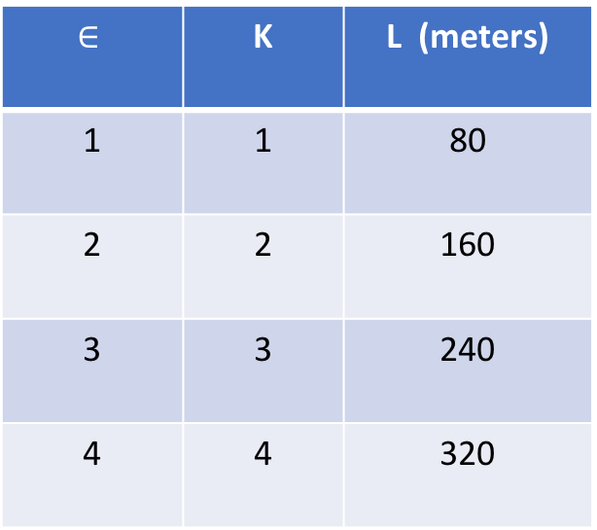

User Defined Privacy Level ($∈$)
Each user chooses threshold values of K & L, if these values are not satisfied then data would not be uploaded to server.
Privacy levels ($∈$) are defined based on values of K and L.
For $∈$=3, k=3 and L=240 meters
$$∈$$ | K | L (meters)
1 | 1 | 80
2 | 2 | 160
3 | 3 | 240
4 | 4 | 320

Slide 46
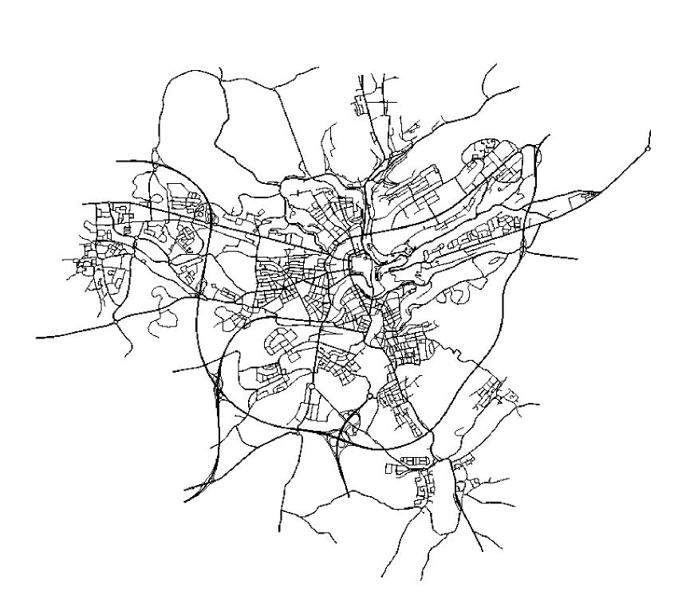
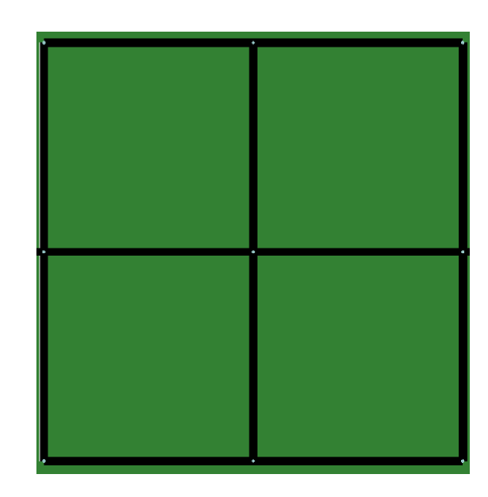
Maps Used
Custom toy map
Luxembourg city map

Slide 47
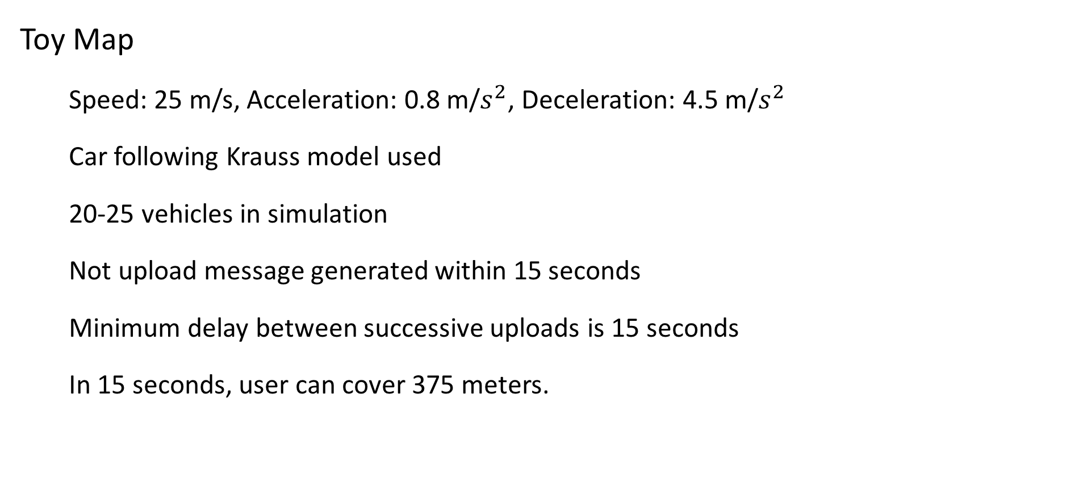
Choice of parameters
Toy Map
Speed: 25 m/s, Acceleration: 0.8 m/$s^{2}$, Deceleration: 4.5 m/$s^{2}$
Car following Krauss model used
20-25 vehicles in simulation
Not upload message generated within 15 seconds
Minimum delay between successive uploads is 15 seconds
In 15 seconds, user can cover 375 meters.

Slide 48
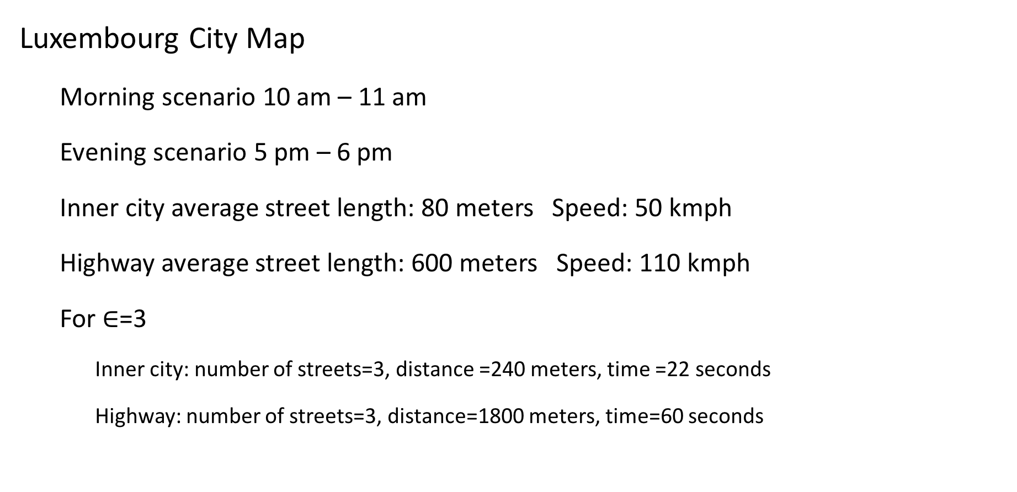
Choice of parameters (cont.)
Luxembourg City Map
Morning scenario 10 am – 11 am
Evening scenario 5 pm – 6 pm
Inner city average street length: 80 meters Speed: 50 kmph
Highway average street length: 600 meters Speed: 110 kmph
For $∈$=3
Inner city: number of streets=3, distance =240 meters, time =22 seconds
Highway: number of streets=3, distance=1800 meters, time=60 seconds

Slide 49
Results

Slide 50
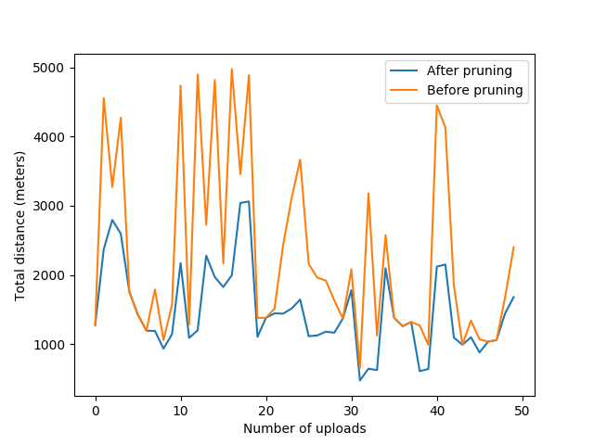
Custom toy map results
1
Minimum value: 475 meters

Slide 51
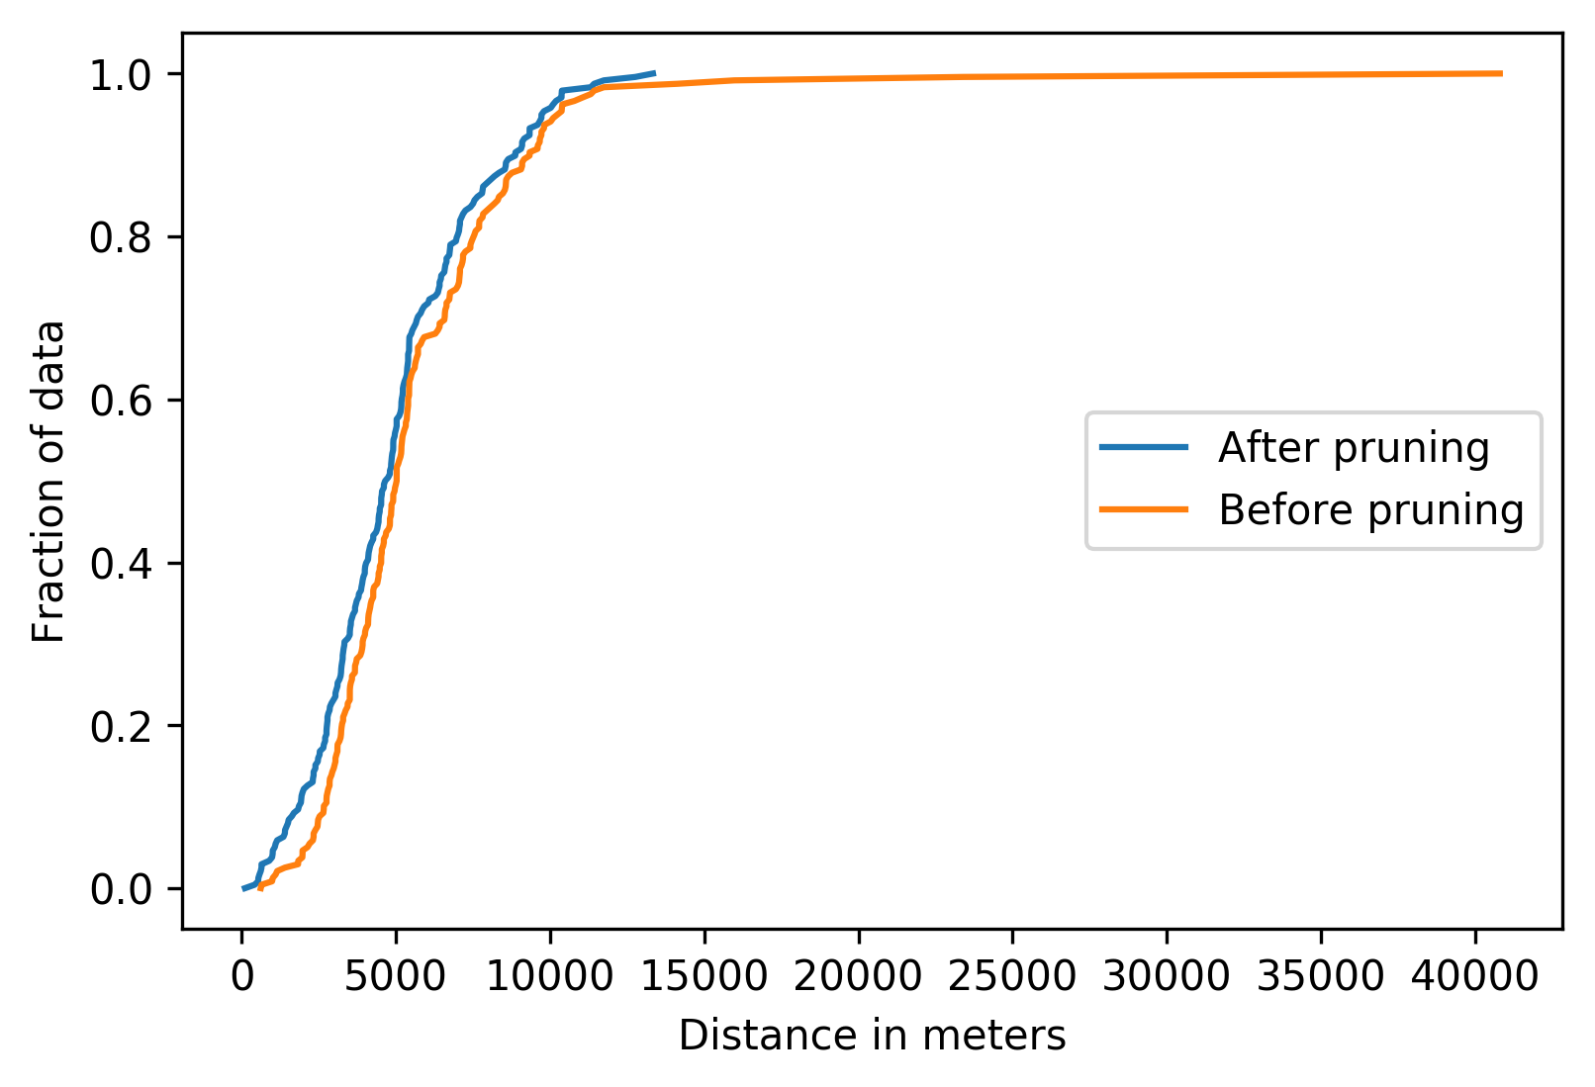
Luxembourg city results

Slide 52
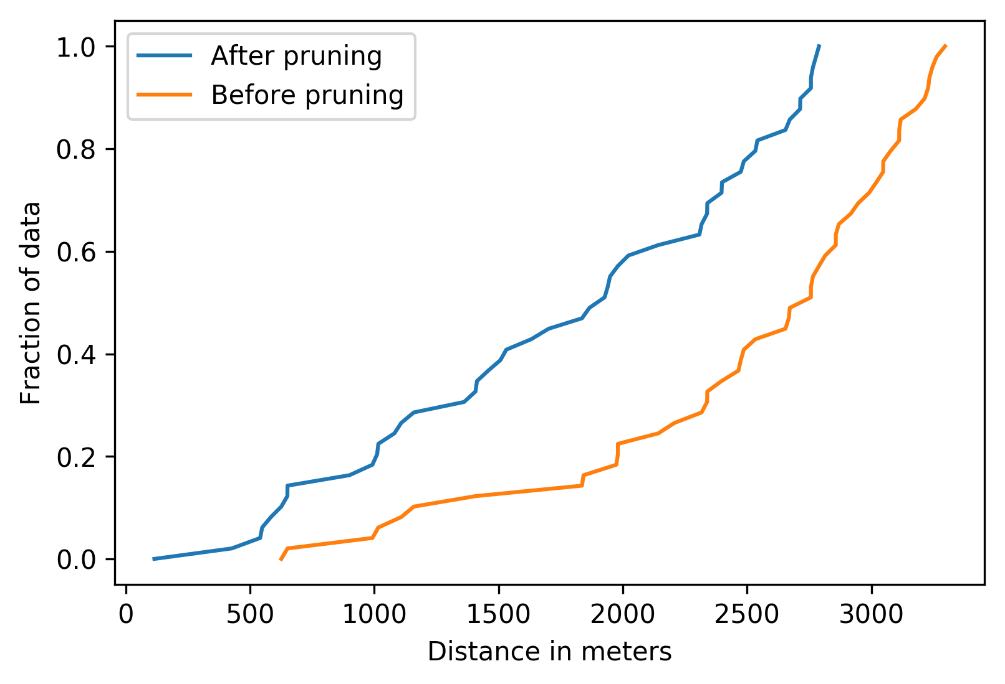
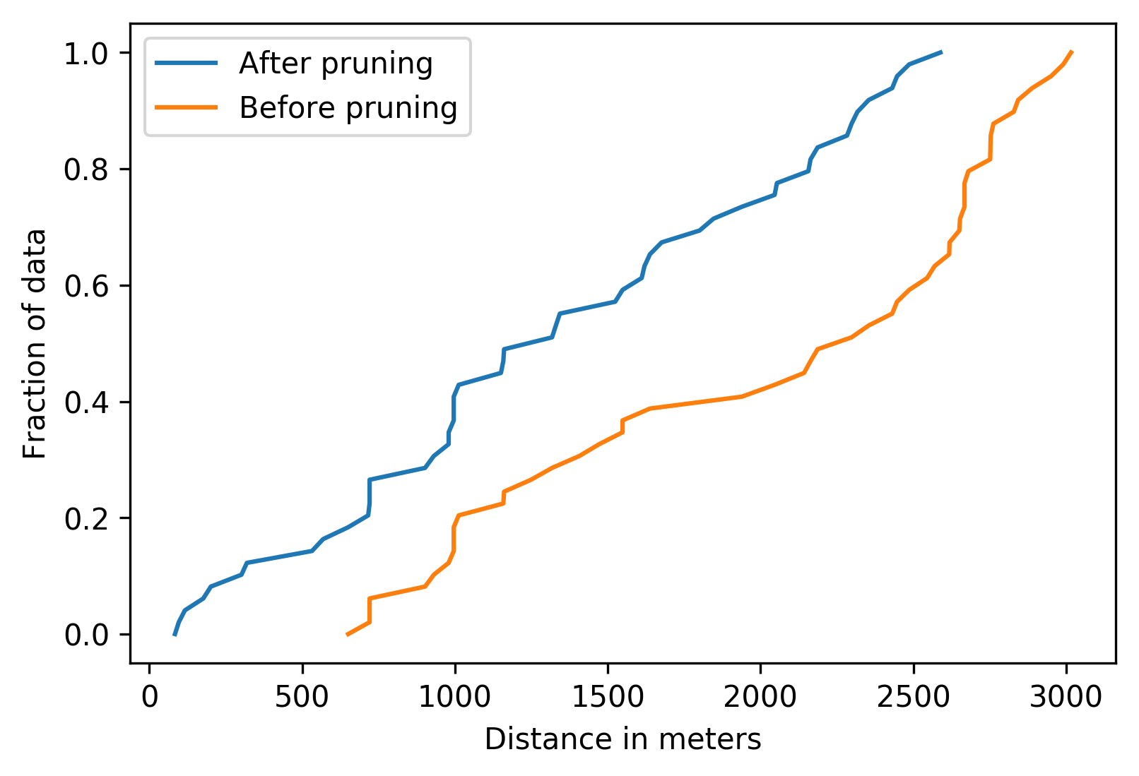
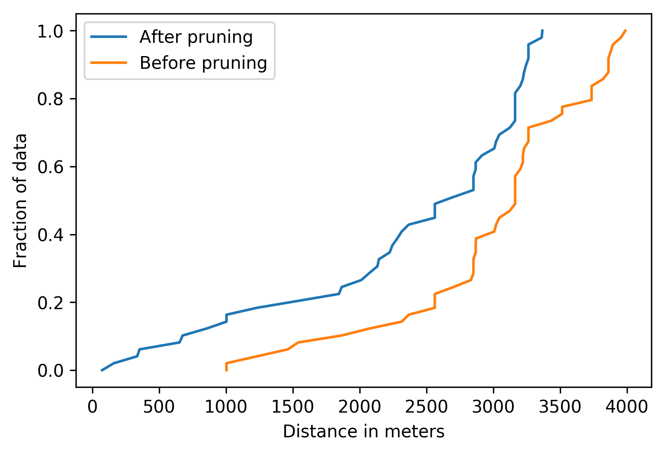
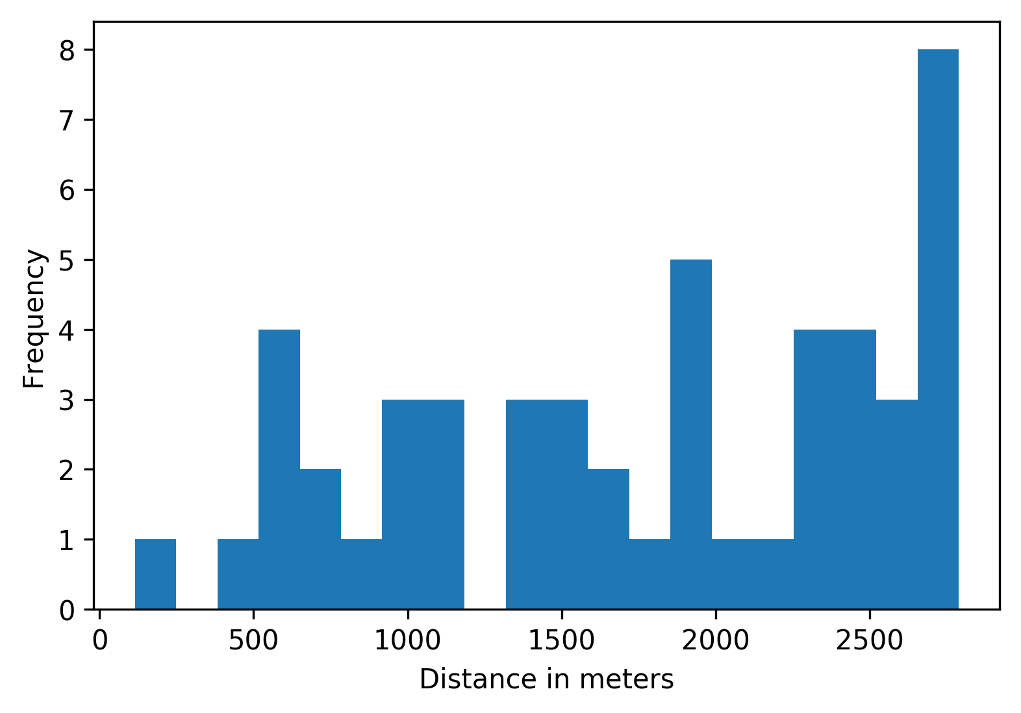
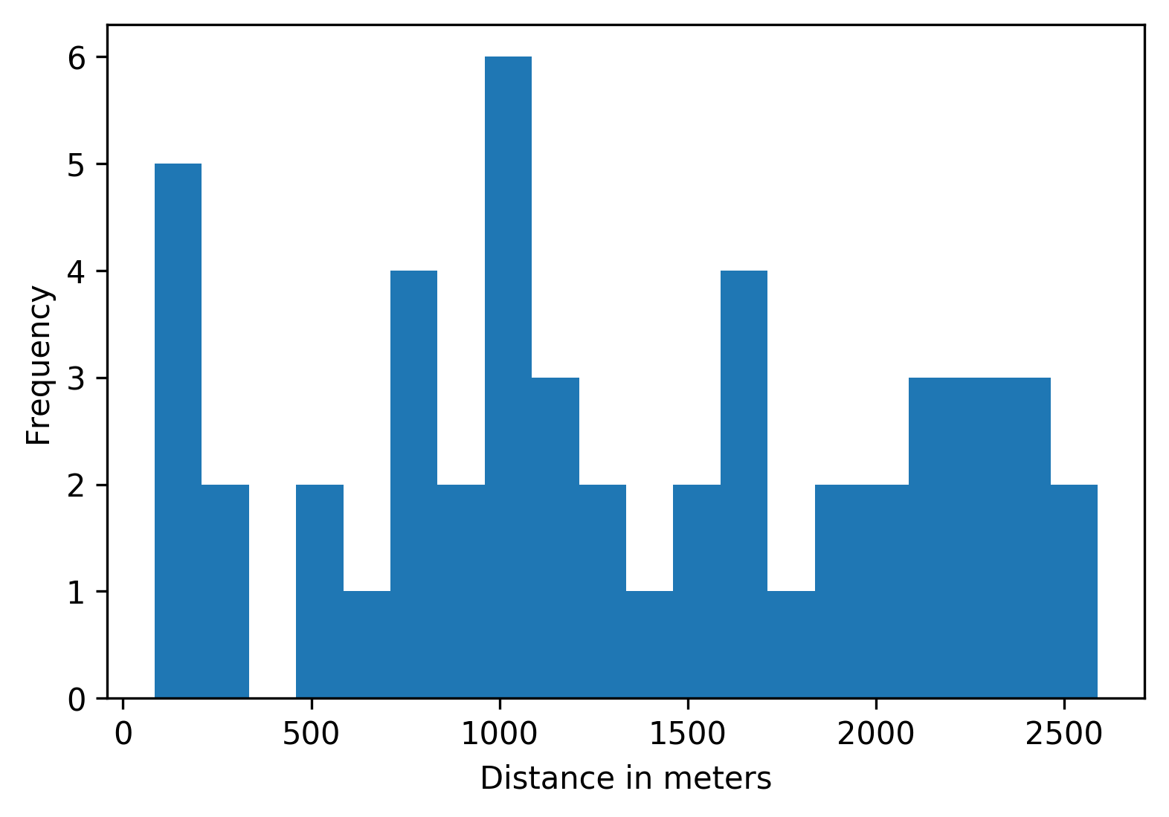
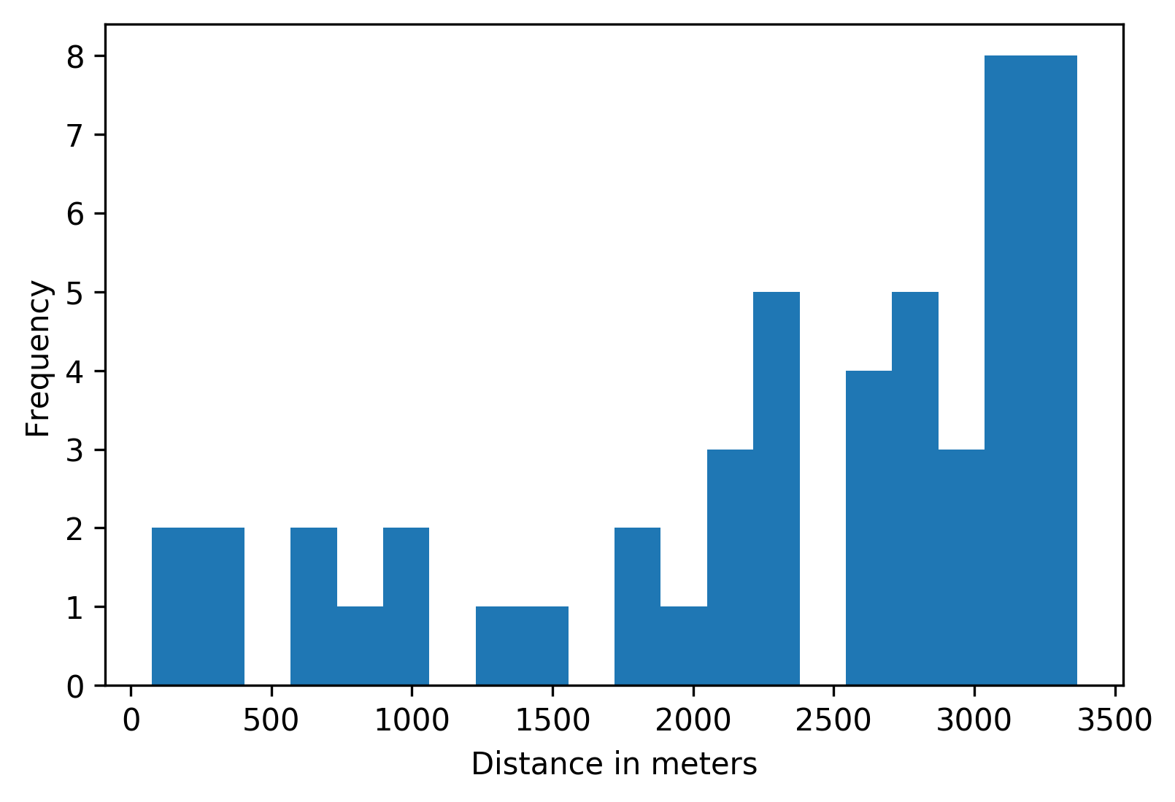
Length of Region of Interest
Inner City Morning
Inner City Evening
Highway Morning

Slide 53
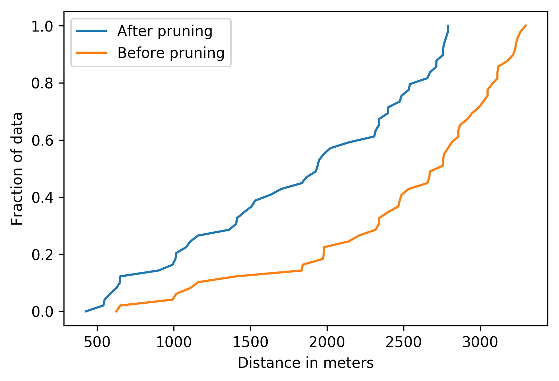
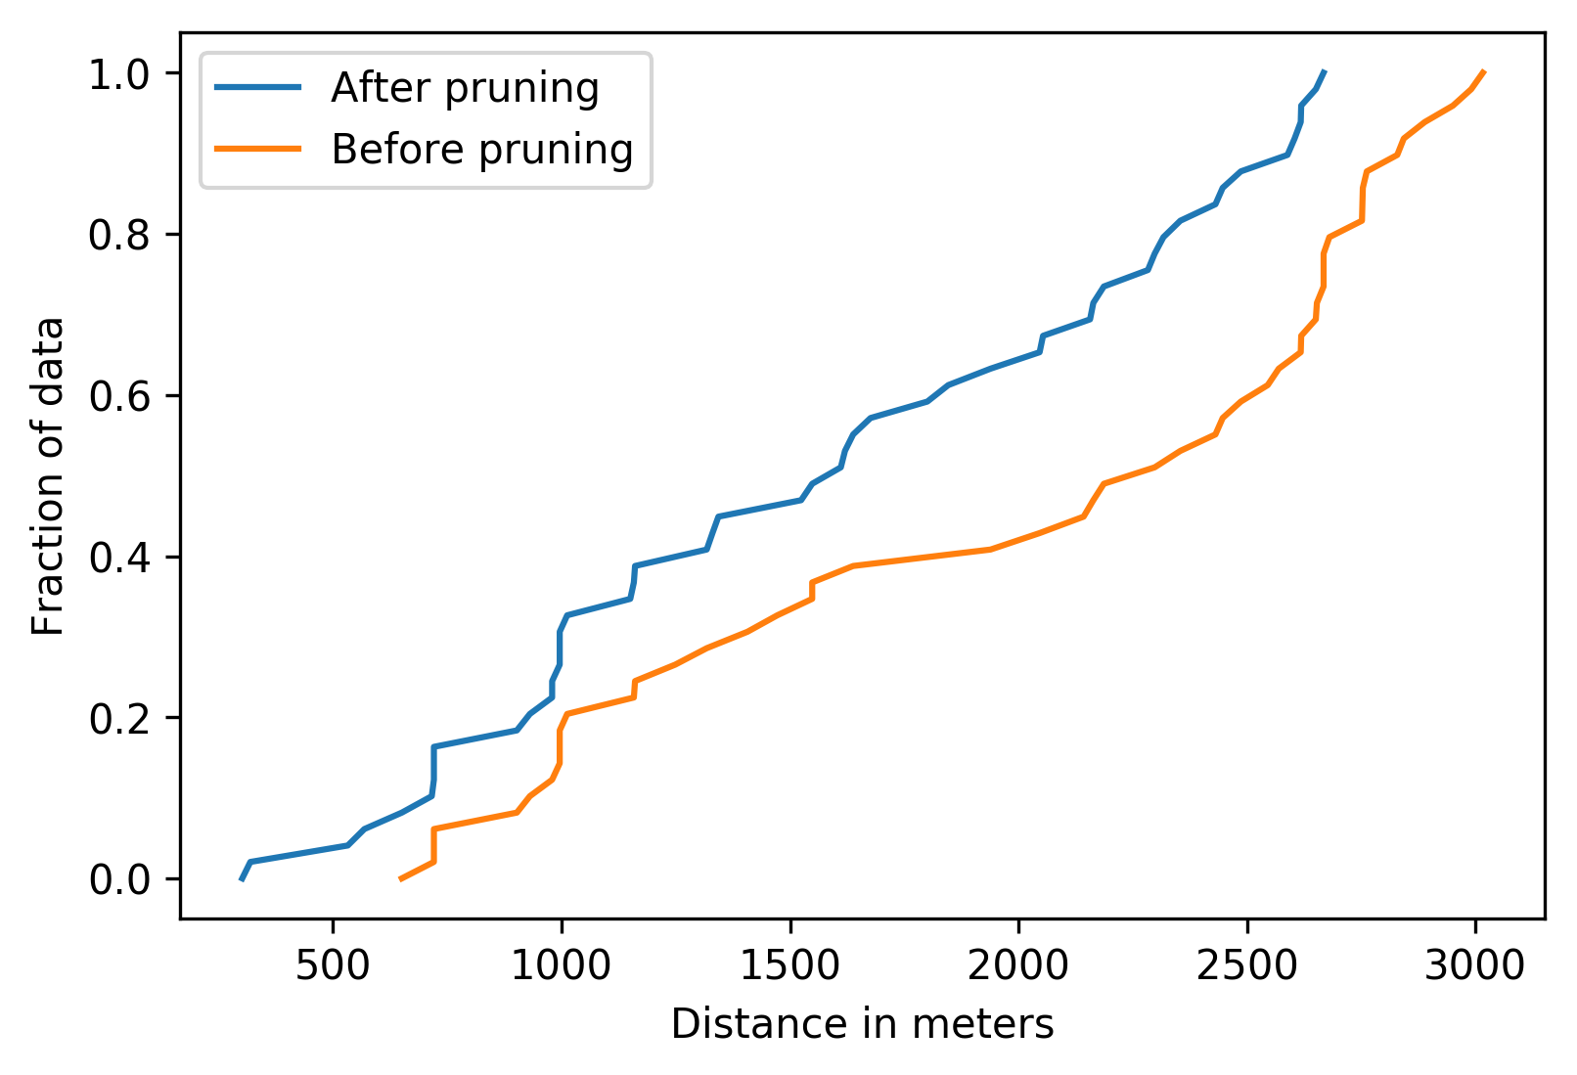
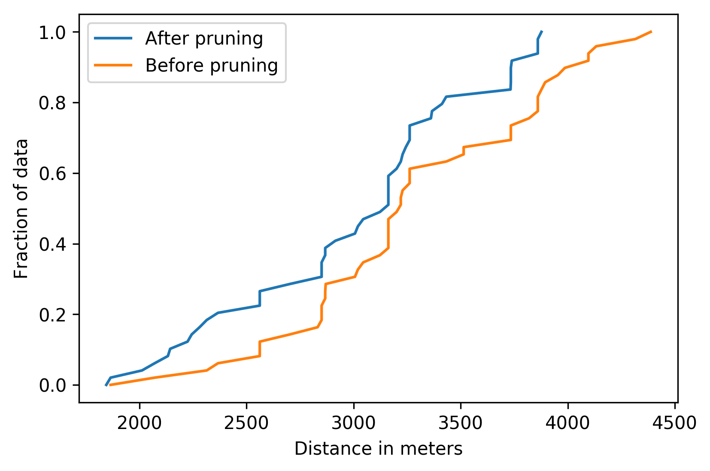
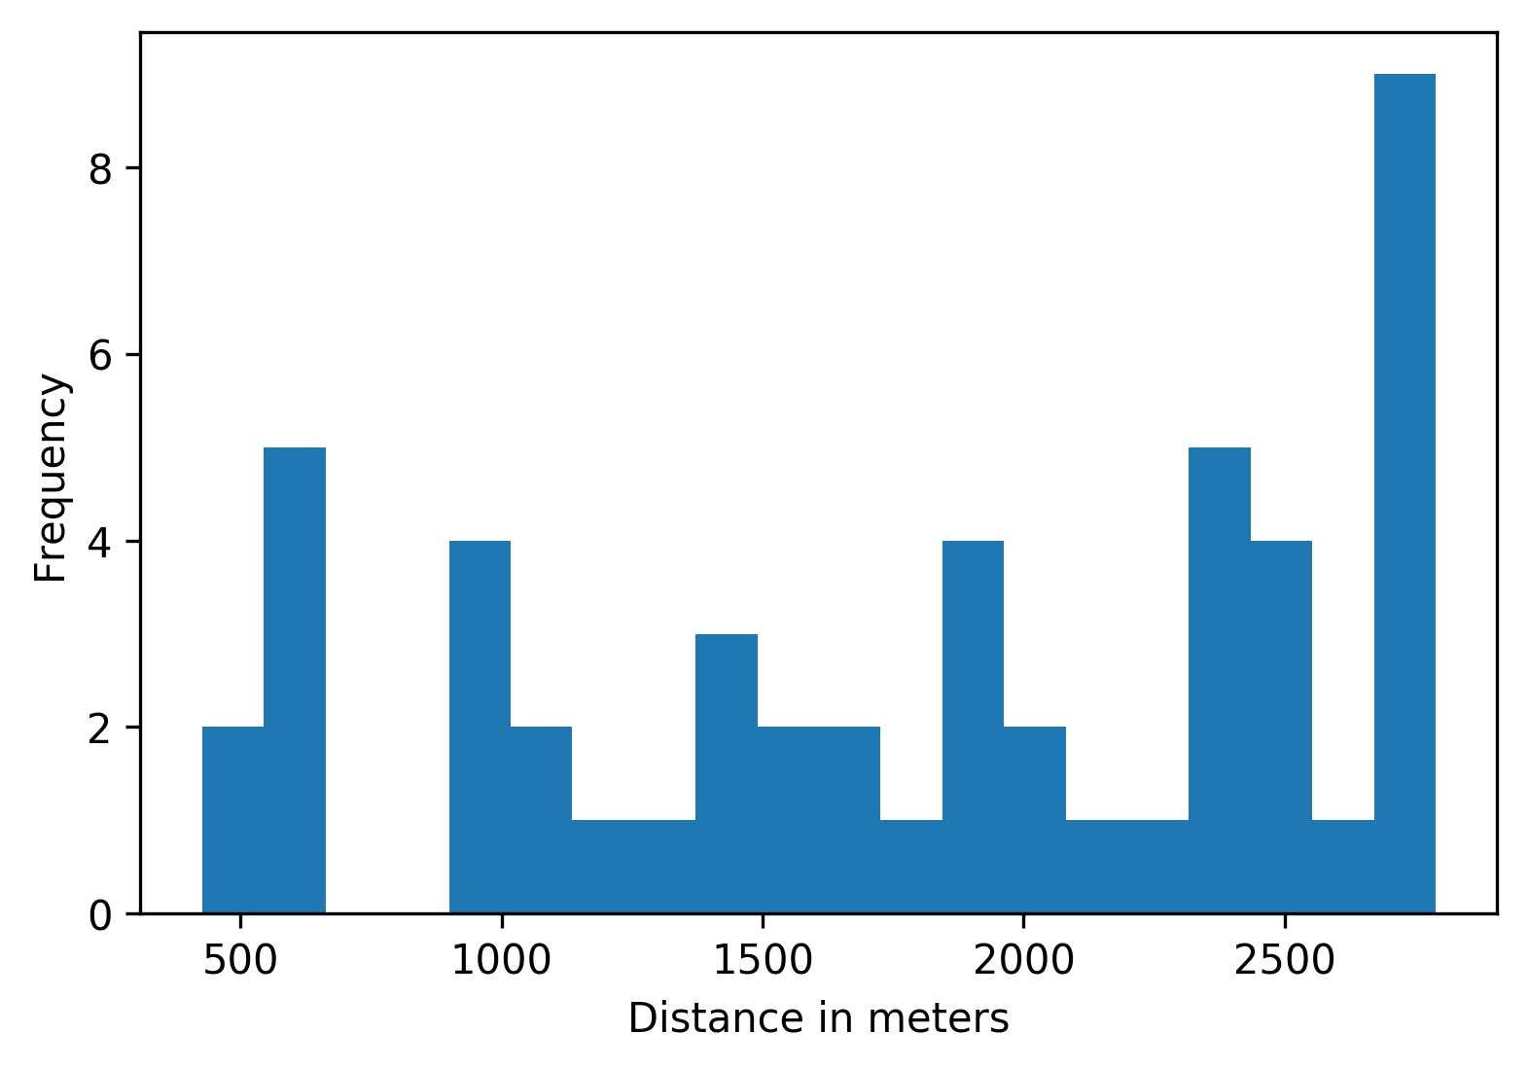
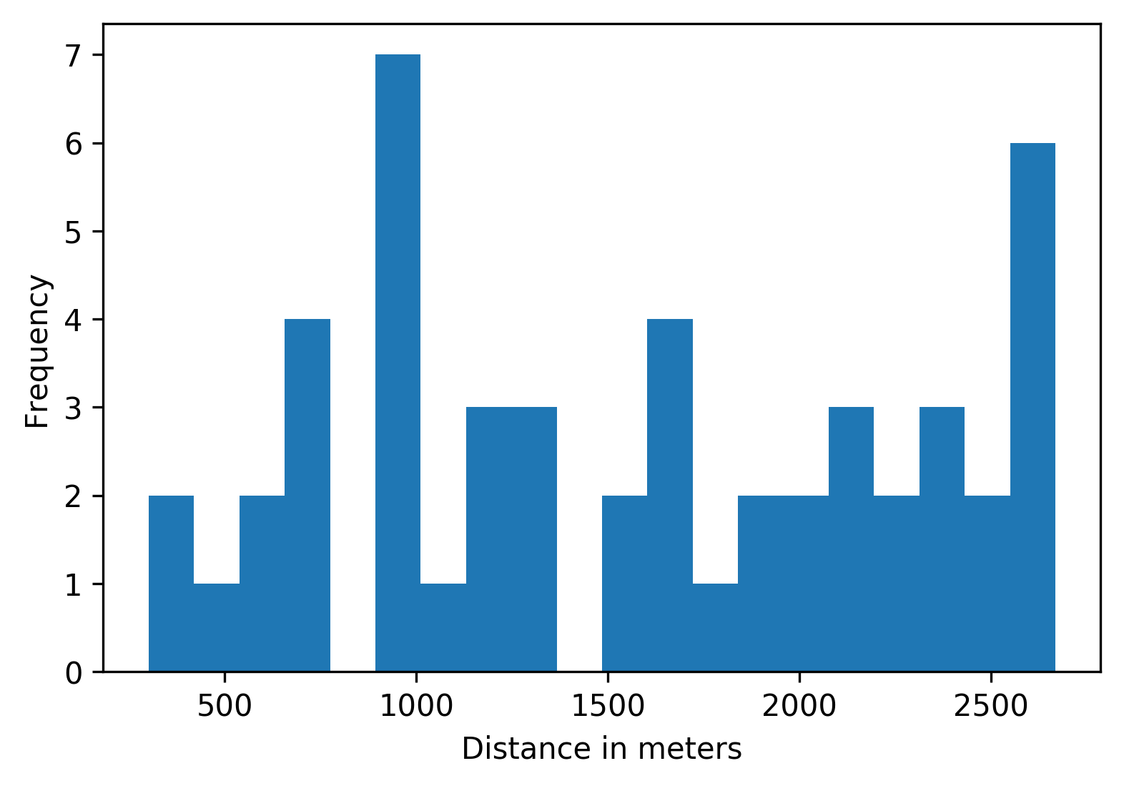
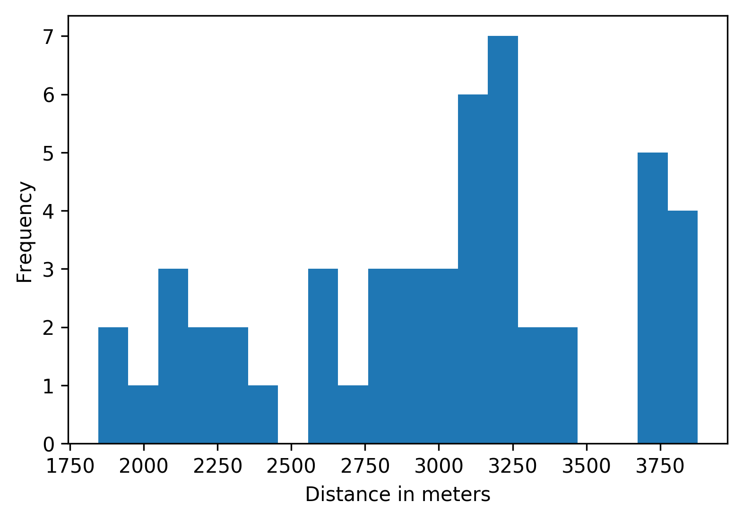
Uploader results
Inner City Morning
Inner City Evening
Highway Morning

Slide 54
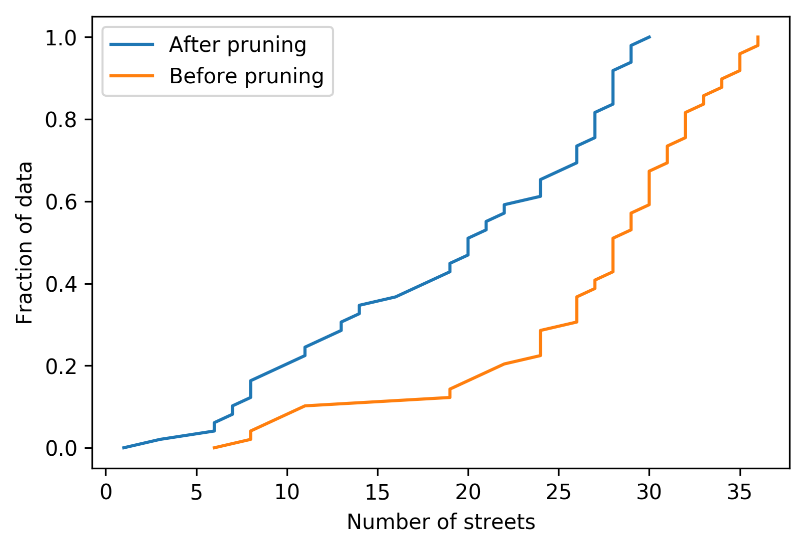
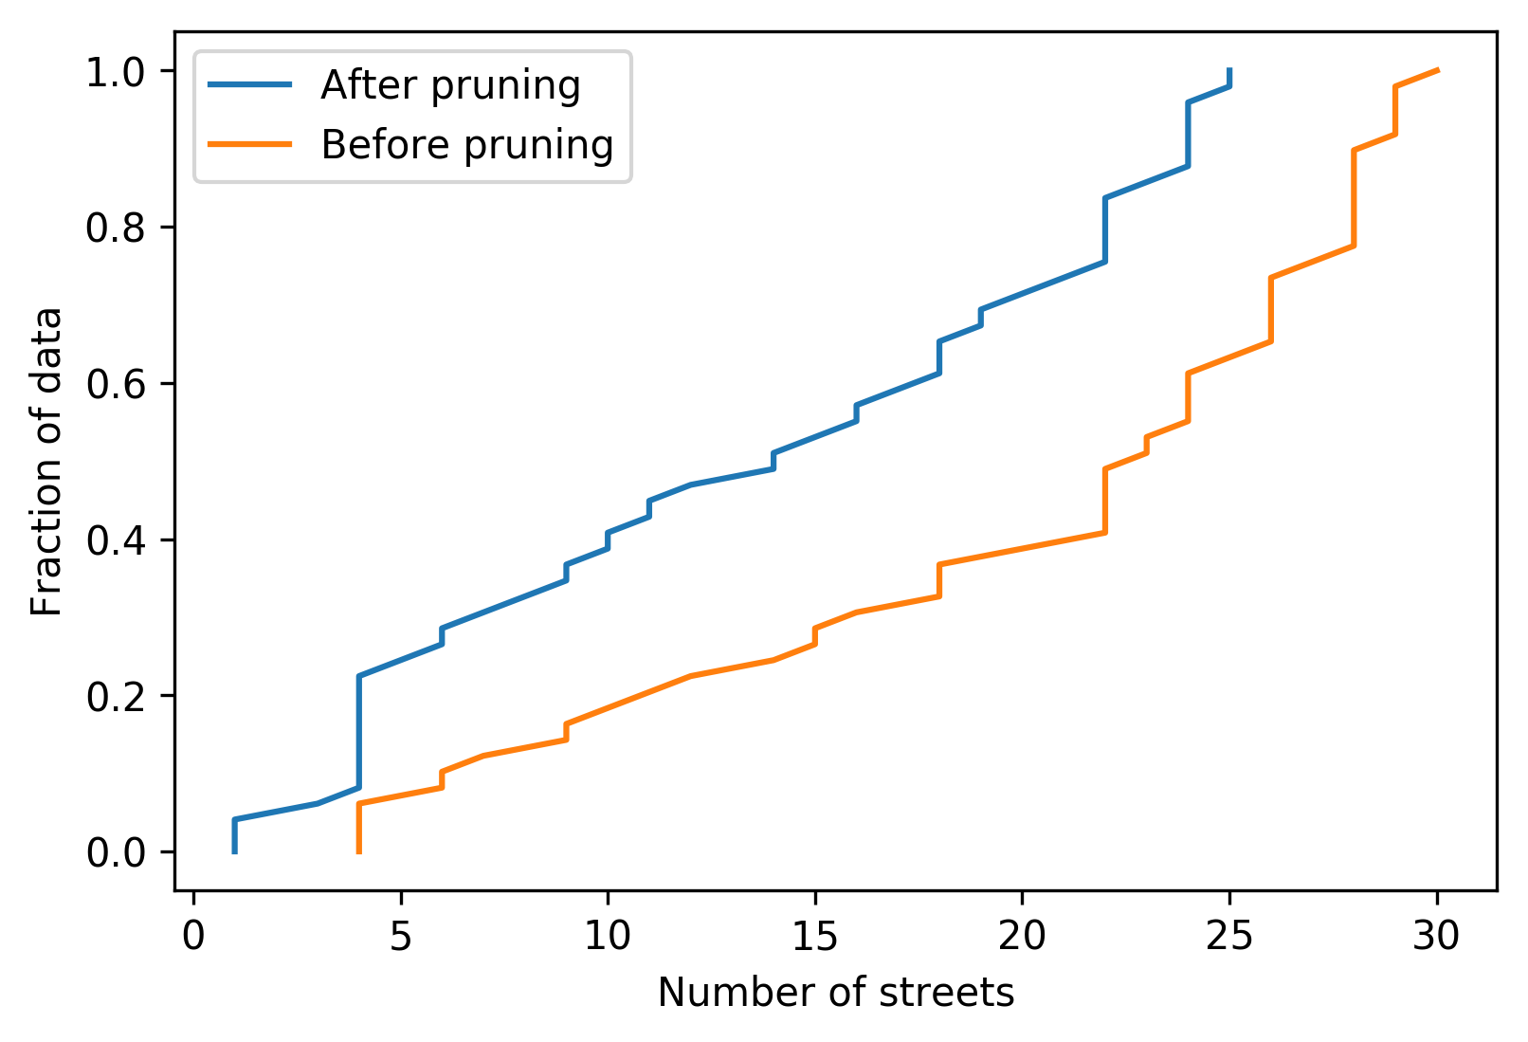
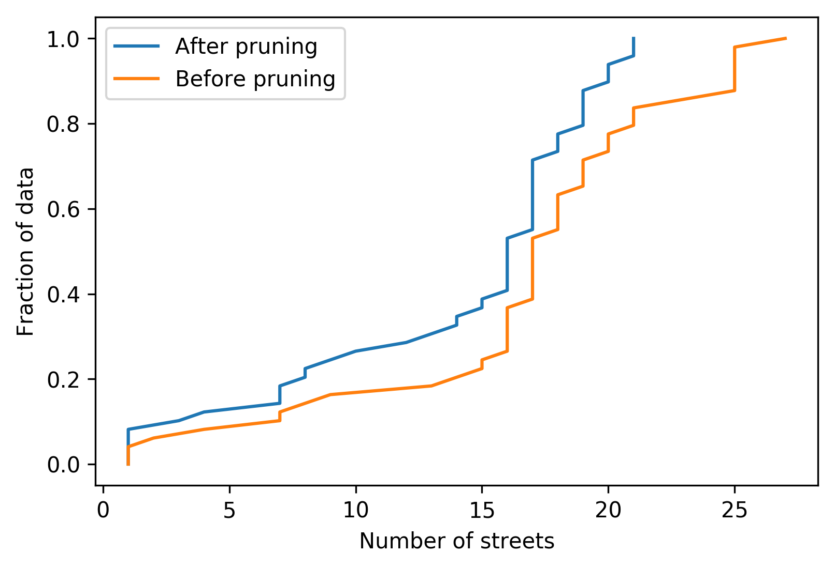



Number of Streets
Inner City Morning
Inner City Evening
Highway Morning

Slide 55






Uploader Results
Inner City Morning
Inner City Evening
Highway Morning

Slide 56
Conclusion
Developed a novel privacy preserving approach for collecting noise free data from vehicular users.
Used random delays and indirections in data collection process.
Formulated an adversary attack to localize users.
If participating users make uploads following our approach, then adversary’s error increases in localizing users.

Slide 57
Future Work
Peer to peer protocol
Intelligently choose neighboring node
Use traffic information to calculate the distance traveled efficiently

Slide 58
Thank you. Questions?

Slide 59
Appendix

Slide 60


Example
Let us assume vehicle is traveling at 40 mph.
Data is reached to the server after 10 seconds. ($t_{server}−t_{0})$=10
r=180 m
In 6 seconds U could have traveled 108 m
$D_{U}^{6}=108$
From C6 draw 108 m lines to C1.
These are potential points U could have been in C1.
As time increases set of potential points would keep decreasing in C1.
At some time (t+m) set of potential points will be very small. [Privacy Loss]
r
z3
r
r
r
z1
r
z2
z4
r
z6
C3
z5
C1
C2
C4
C6
6 second scenario
C5

Slide 61
Challenges
To simulate real vehicular environment & make vehicles communicate with each other.
Keep track of large number of vehicles & messages which are being transmitted.
Scaling issues due to broadcast nature of protocol.

Slide 62
Would you still collect the data if privacy is not preserved??
NO!
NO!
NO!
NO!

Slide 63
Dynamic Congestion map of a city
Route Planning
Travel Demand Modeling
Different Applications tied to Location Based Data
Validating transportation data from other sources
Emissions and air pollution modeling
Climatic change impact studies
City Infrastructure Modeling
Homeland Security Evacuation

Slide 64
Our Contributions
Introduce Random Delays & Indirections in data collection process to preserve privacy of vehicular users.
Formulate adversary attack to localize users based on multiple uploads made by the same uploader.
Develop proactive approach to prevent the adversary from localizing participating users.
Run simulations on a custom toy map and a real world traffic scenario to evaluate our approaches.

Slide 65

Algorithm for Custom Toy Map
Removing points from previous circles

Slide 66

Algorithm (Real world)
Localized uploader
Graph Pruning
Localized uploader

Slide 67


Uploader Algorithm
Graph Pruning
Not safe to upload
Safe to upload

